Slide 1





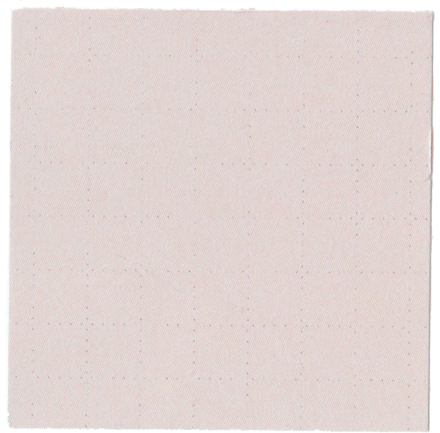





LET'S PLAY
TIC
TAC
TOE

Slide 2
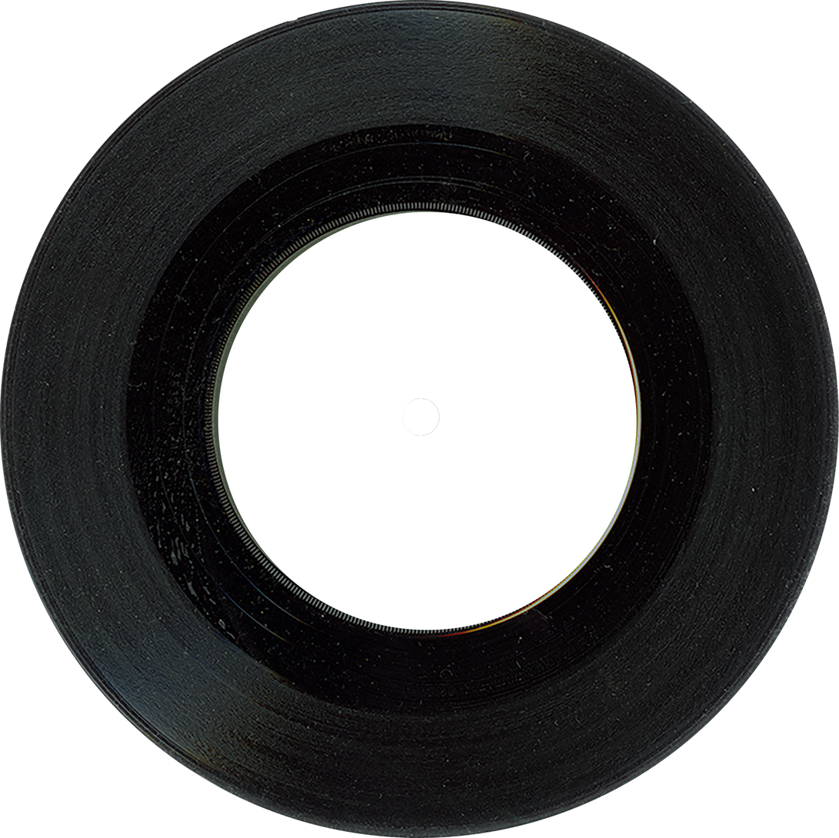

Team & Project Identity
TechiGuys
Name
Reg. no
Batch
Dept
Year
Dohal
22BCE7746
Batch-2
CSE
4th year
Koushik
22BCE7378
Batch-2
CSE
4th year
Yathnesh
22BCE20350
Batch-2
CSE
4th year
Tansheed
23BCE7541
Batch-2
CSE
3th year
Nikhil
22BCE20380
Batch-2
CSE
4th year
Venkata Kiran
22BCE7098
Batch-2
CSE
4th year

Slide 3
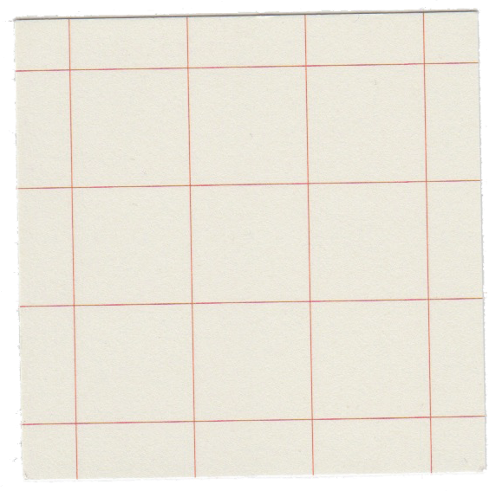

Problem Overview
Problem Identification
People often experience short periods of boredom during daily routines — such as commuting, waiting in lines — where they seek quick, engaging activities.
User Impact
Boredom negatively affects productivity and mood. A simple game like Tic Tac Toe provides a mental refresh in just a few seconds or minutes. It helps users pass time enjoyably without requiring much attention or device resources.
Market Gap Analysis
While there are many mobile games available, many are either too time-consuming, overly complex, or filled with ads and distractions. There is a gap for a minimal, and ad-free version of a classic game— optimized for casual play anytime, anywhere.
Problem Validation
Informal surveys and user feedback indicate that many android users look for simple games to kill time. The enduring popularity of retro games like Tic Tac Toe shows continued interest, especially among those seeking stress-free gameplay.

Slide 4
Solution Overview
Core Innovation
Our Android Tic Tac Toe app offers a fast, intuitive, and distraction-free gameplay experience. Designed with simplicity and fun in mind, it includes offline play, clean UI, and smart AI for solo challenges — filling the boredom gap with quick, satisfying matches.
Key Benefits
Users enjoy instant play without setup hassles, smooth interaction, and the choice of playing against friends or AI. The app enhances free moments with light mental stimulation, offering both entertainment and engagement on demand.
Technical Edge
Built using modern Android development tools like Kotlin, Jetpack components, and MVVM architecture, the app ensures responsive performance and easy scalability. The lightweight design ensures compatibility with a wide range of devices, even with limited storage or connectivity.

Slide 5
layouts-linear
networking- retrofit
Game Resource
Page
local storage- no(cloud storage)
data binding - firebase connection
additional tools - firebase services

Slide 6
Dohal-Logic Building
Nikhil-Logic Building
Contribution
Koushik-Data base Connection
Yathnesh - UI
Tansheed - Styling
Kiran - Whole Administration

Slide 7

Thank you
for playing!

